Slide 1

TEAM 31: CARNET REVIEW
Pooja Tewari
Shivangi Chand
Siddharth Dhar
Sripath Mishra

Slide 2
SRIPATH MISHRA

Slide 3




BACKEND

Slide 4
SIDDHARTH DHAR

Slide 5
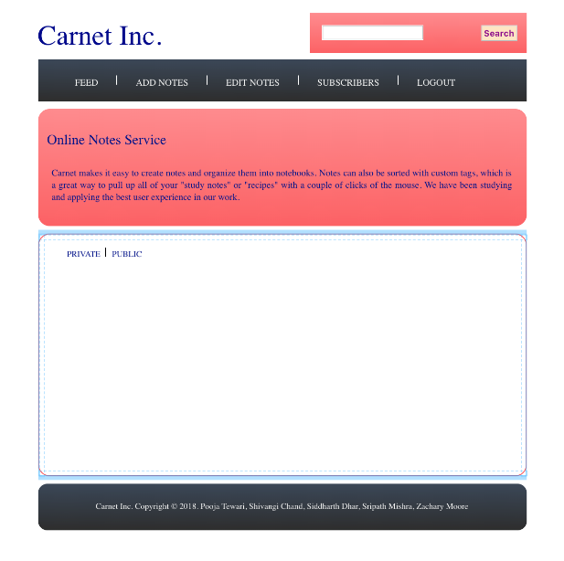

Slide 6
SHIVANGI CHAND

Slide 7
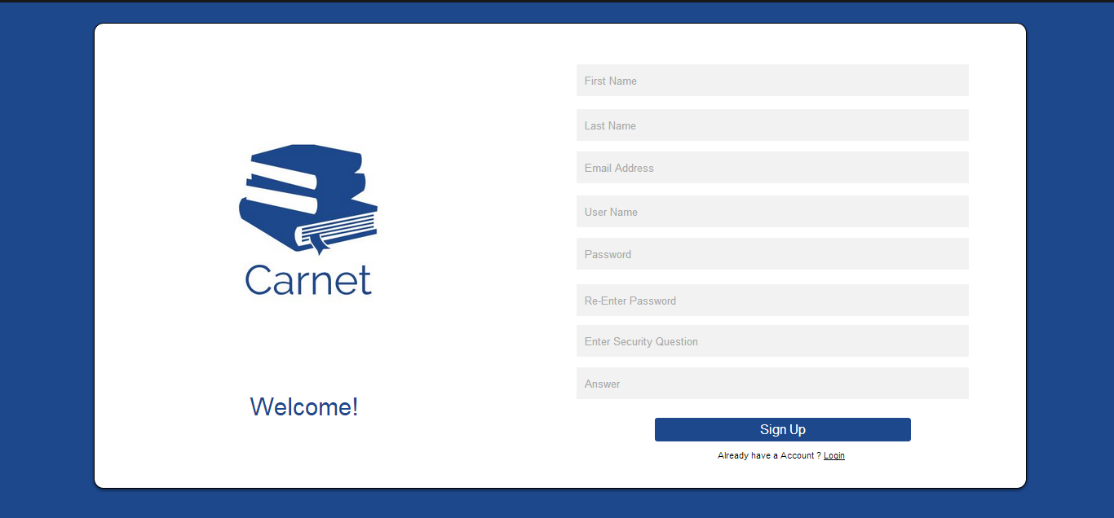

Slide 8
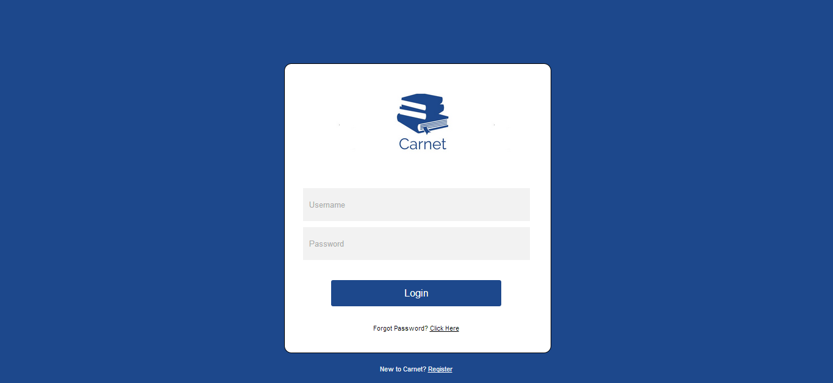

Slide 9
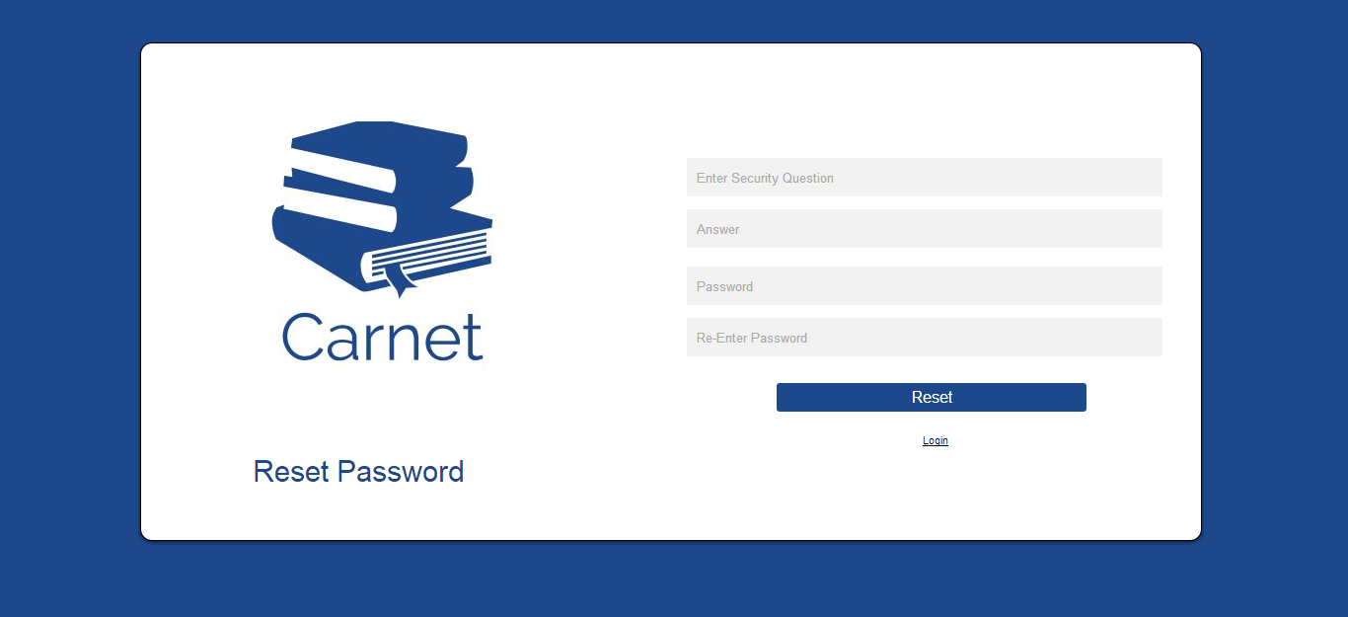

Slide 10
POOJA TEWARI

Slide 11


